Slide 1

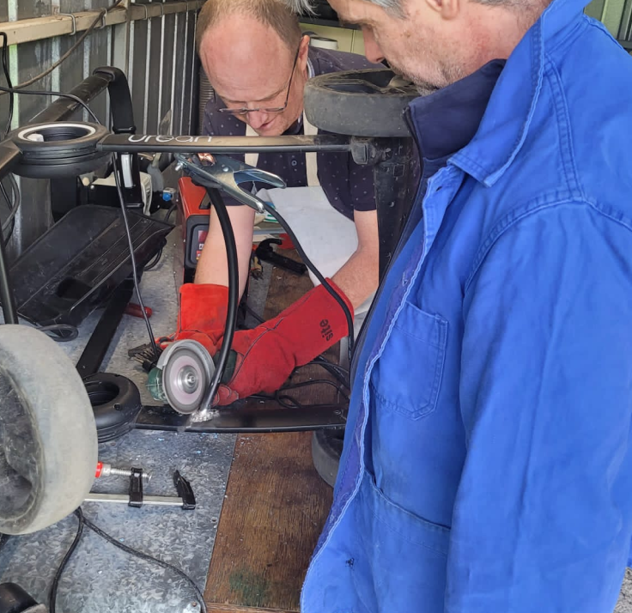
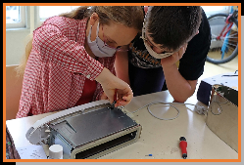
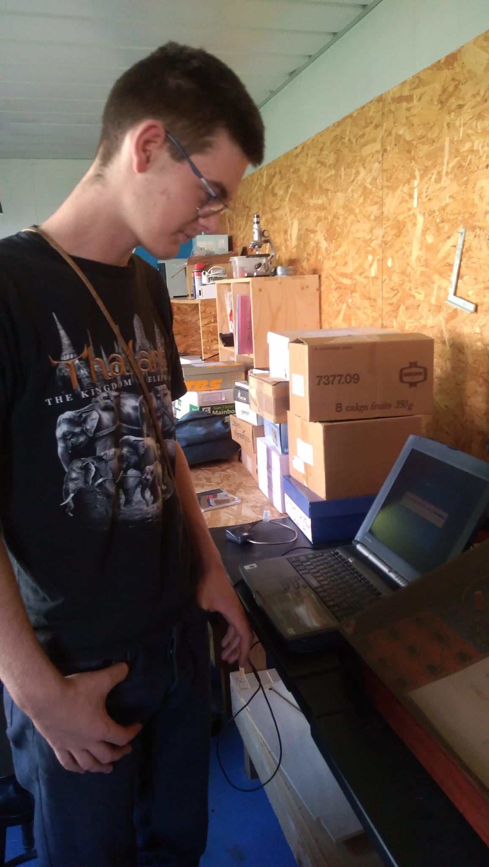
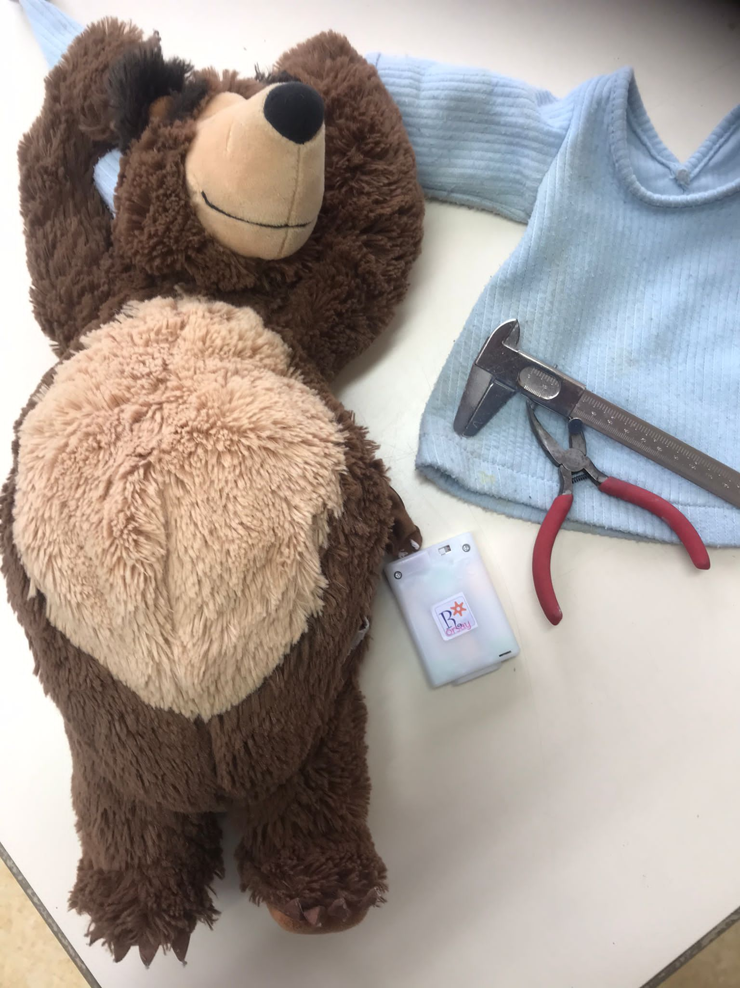
ATELIERS REPAIR CAFE
PROTO 204
ATELIER TEXTILE NUMERIQUE BOIS SOUDAGE …
https://repaircafe-orsay.org

